Slide 1

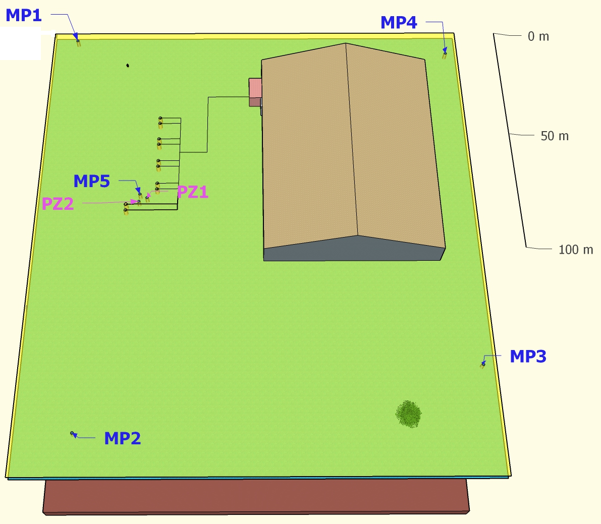
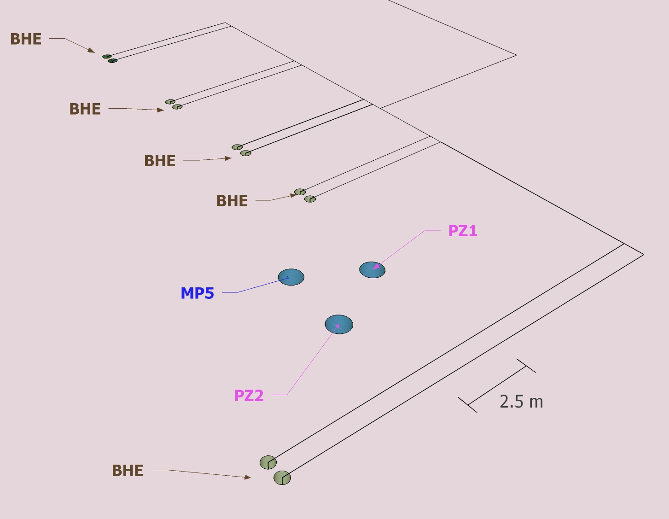
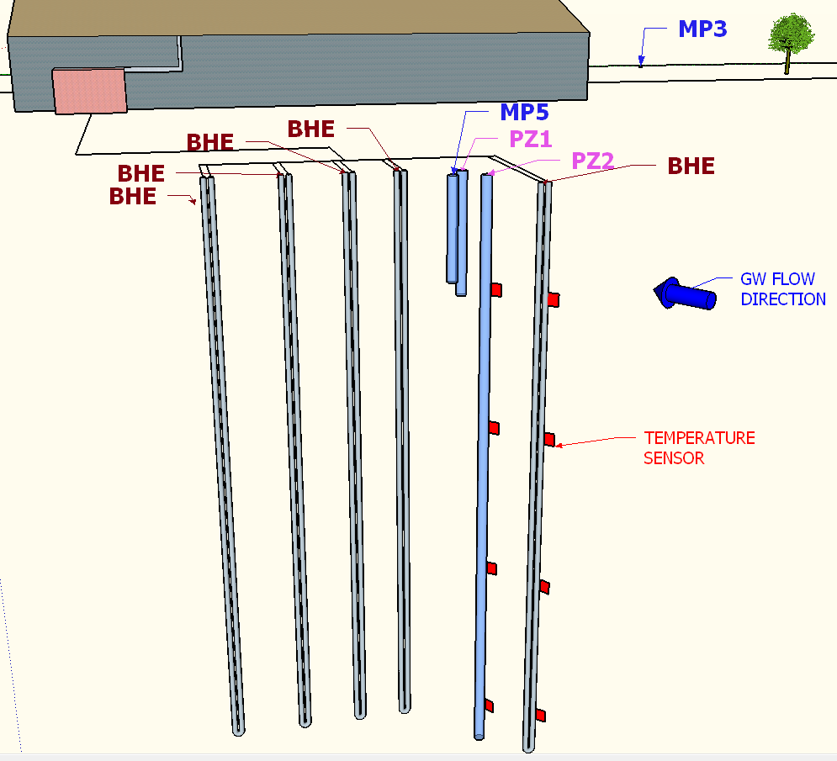
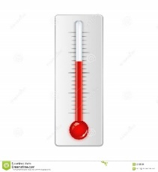
The interaction between ground source heat pump and the aquifer: a zootechnical pilot test case study
Formentin G.^{1 }, Legrenzi C. ¹, Angelotti A. ²
¹ Tethys Srl, viale Lombardia 11, 20131 Milano, Italy
² Dipartimento di Energia (D.En.), Politecnico di Milano, via Lambruschini 4, 20156 Milano, Italy
 Corresponding author giovanni.formentin@tethys-geco.it
Ground source heat pumps are commonly installed in residential and commercial buildings. There are fewer examples in the zootechnical sector and almost all, to the authors’ knowledge, apply horizontal exchangers.
In the framework of the EcoZoo project, funded by the Lombardy Region and MIUR (Ministry of Instruction, University and Research), a pilot test site was set up comprising a ground source heat pump with 5 borehole heat exchangers (BHEs) and 7 monitoring wells (MWs).
TEST SITE OVERVIEW
BHEs AND MONITORING SYSTEM
BHE: borehole heat exchangers
BHE1 is equipped with fixed temperature sensors
MPx: groundwater monitoring wells (0.75”, 8 to 11 m depth) to assess gw direction
PZ1: 4”, 60 m monitoring well equipped with fixed temperature sensors
PZ2: 3”, 12 m monitoring well
GEOTHERMAL HEAT PUMP SYSTEM
THE GEOTHERMAL HEAT PUMP SYSTEM
The system provides heating, cooling and ventilation to a piglet room at the “Experimental Didactic Zootechnical Centre” of the University of Milan in Lodi, Northern Italy. The room, 50 m² wide, hosts up to 100 piglets from two to six months old requiring both a constant temperature of 22-28°C year round and 1200 m³/h of clean air.
The BHEs were installed in the shallow aquifer (down to a depth of 60 m) providing a total exchanging length of 300 m. Preliminary interpolation of groundwater levels measured in the MWs allowed for the design of an optimal BHE layout, minimizing the risk of overlapping the BHE heat plumes. The heat pump feeds an air handling unit which recovers the heat (78% recovery efficiency) from the exhausted air. All the components were tailored to the specific needs of the room and its occupants.
THE EXPERIMENTAL MONITORING SYSTEM
A monitoring system, provided by the Department of Energy of Politecnico di Milano*, records a set of parameters such as aquifer temperatures in the BHEs and the MWs together with air and water flow rates, temperatures and electrical consumption. The data are being used to implement a heat transport model (MODFLOW-2000 and MT3D) and to assess the overall system performance.
EXPECTED RESULTS
The main expected results from this application are twofold: a drastic reduction in energy consumption from the pre-existing gas burner and a measurable increase in animal welfare due to the improved control of temperature and air exchange along with cooling in summer. Moreover, the ongoing study will enhance knowledge of the interaction between BHEs and the aquifer helping to design more efficient BHE configurations.
* See the poster Numerical simulation of a geothermal system for a piglet room, Alberti L., Antelmi M.
HEAT PUMP - COOLING
Cooling capacity P_{f} = 15.9 kW
Water temperature - user side = 10÷15°C
Water temperature - ground side = 30÷35°C
Energy Efficiency Ratio EER = 4.2
HEAT PUMP - HEATING
Heating capacity P_{t} = 14.4 kW
Water temperature - user side = 40÷45°C
Water temperature - ground side = 0÷3°C
Coefficient Of Performance COP = 3.2
T=28°C
AIR HANDLING UNIT
Air flow rate | 1200 m³/h
Recovery efficiency | η = 78%
GROUND HEAT EXCHANGERS
5 U-pipe exchangers @ 60 m depth

