Slide 1
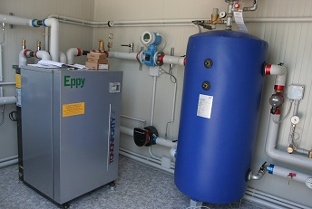
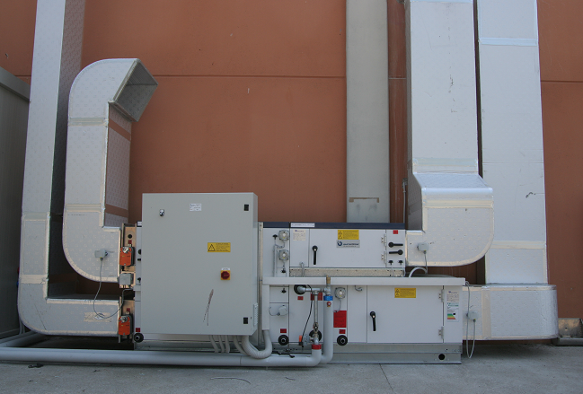
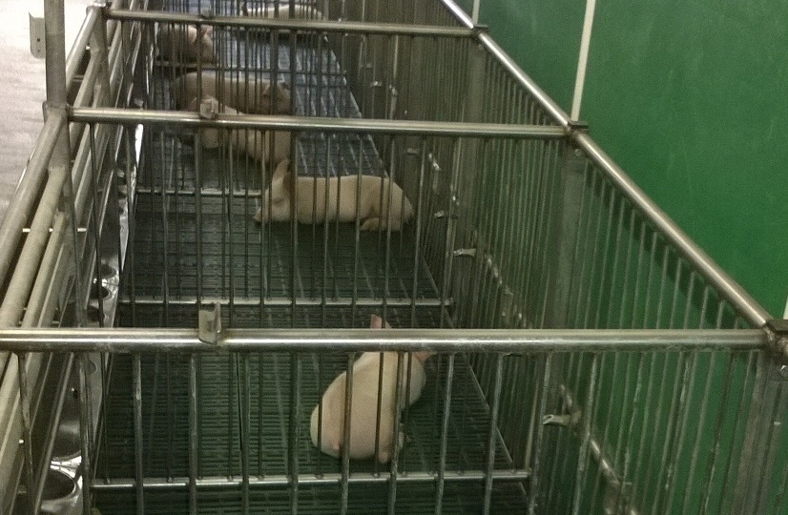
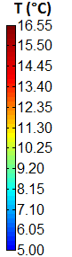
Numerical simulation of a geothermal system for a piglet room
Alberti L.¹, Antelmi M.¹ ²
¹ Dipartimento Ingegneria Civile e Ambientale (D.I.C.A.), Politecnico di Milano, Piazza Leonardo da Vinci 32, 20133 Milano, Italy
² Dipartimento di Energia (D.En.), Politecnico di Milano, Via Lambruschini 4, 20156 Milano, Italy
Introduction: In the framework of the EcoZoo project funded by Lombardy Region and MIUR (Ministry of Instruction, University and Research), Tethys Srl contracted Politecnico di Milano – the Department of Energy and the Department of Civil Environmental Engeneering, in order to implement and monitor a ground source heat pump plant providing heating, cooling and ventilation to a piglet room. Especially, it was monitored a set of different parameters, regarding the energy and temperature in subsoil, in order to numerically model the environmental impact on groundwater system.
Pilot plant characteristics: The 50 m² room hosts up to 100 piglets from four to ten weeks old, requiring a constant temperature (in every season) of about 28°C and an air renewal of 1200 m³/h. The system is composed of 5 Borehole Heat Exchangers (BHEs) 60 meters deep, a heat pump and an air handling unit (AHU), including a heat recovery with an efficiency of 78%. Furthermore 7 monitoring wells were built up in order to monitor the thermal plume evolution into the subsoil.
1. The monitoring System
A monitoring system was set up using LabVIEW (National Instruments) code, an object base programming code, in order to assess the energy balance of the system and the interaction with the aquifer. This customized program acquires several parameters, in real time, such as:
BHEs and monitoring wells temperature at 4
different depths;
Thermal-carrier fluid temperature into the hydraulic
pipes of the heat pump;
Air and water flow rates into the pipes of heat pump
and AHU;
Air humidity and temperature into the aeraulic pipes
of the AHU (at the inlet/outlet of the room);
Electricity consumption of heat pump and AHU.
3. Results: monitoring system vs numerical model
Starting from the data inferred from the monitoring system, the numerical model was calibrated. Specifically several parameters, such as inlet temperature, stress period numbers, hydraulic and thermal properties, were calibrated in order to match the numerical solution with the experimental data. The observation points, where the absolute or variations temperatures of two solutions were analysed, are:
Absolute temperature at the outlet pipe of the BHE 1:
Temperature variations towards the undisturbed ground into the grout of the BHE1 (0.06 m downstream the center of BHE)
After a heating operation (for 17 d period), the model shows that the thermal plume length into the layer 6, which corresponds to the depth where a sensor is located (-25 m from ground), is nearly equal to 4.5 m downstream the BHE.
Front Panel
2. The numerical model
Thanks to a detailed hydrogeological and geological characterization of the site, a heat transport model was implemented into MODFLOW/MT3D code adapting the single BHE model developed by Angelotti et al. (2014) to the case study. The aim was to understand the heat exchange process into the aquifer. MODFLOW is a full 3D finite difference code for groundwater flow simulations, while MT3DMS is a modular three-dimensional multispecies code for contaminants and temperature transport, able to consider advection, dispersion, diffusion and heat storage in groundwater systems.
The circular geometry of the pipes was turned into an equivalent square geometry, by imposing the conservation of the total thermal resistance between fluid and U-pipe;
Domain vertical dimensions: 80 m;
Domain horizontal dimensions: 60 m x 200 m;
Boundary and initial flow conditions:
Porous medium: saturated heterogeneous aquifer (sand with silt and gravel), as depicted from the geognostic survey and two constant hydraulic gradient across the horizontal section for shallow and deep aquifers.
BHE: constant mass flow rate (nearly 500 kg/h) according to monitoring system results;
Properties: hydraulic conductivity and porosity were calibrated through a mathematical modeling that reproduced the pumping test
Boundary and initial thermal conditions:
Porous medium: different initial temperature (for undisturbed ground) varying from top (16.55°C) to bottom (14.19°C) and same thermal gradient at the upstream boundary;
BHE: inlet temperature varying from 8.85°C (day 1) to 5.59°C (day 17) according to daily operational schedule;
Properties: thermal conductivity, dispersivity and distribution coefficient acquired from bibliographic research and thermal response test.
Temperature variations into the monitoring well P1 (1.93 m downstream the center of BHE1)
Model plan
view
Conclusions:
Taking advantage of the acquired data, the validation of the numerical model compared with the experimental data was assessed. Through the calibration of hydraulic and thermal parameters, a good accordance between numerical and experimental data was found; so, the numerical model correctly reproduces the heat transfer into the aquifer. It was also possible to deeply thermally typify the aquifer and to reproduce the real length of the thermal plume, after a typical heating operation.
In the near future, it will be necessary to test the model during a typical cooling operation and also to adapt it in order to reproduce a real thermal response test. The model is the basis for next simulations that will allow to better understand the heat transfer into different aquifers.
Furthermore, carrying this activity research on, the influence of several thermal parameters will be analyzed through this model. Starting from the study of the variation of these parameters, it will be possible to better simulate the BHE, without using an extremely refined grid, nowadays essential to reproduce the U-pipe shape.
References:
Angelotti A., Alberti L., La Licata I., Antelmi M., Borehole Heat Exchangers: heat transfer simulation in the presence of a groundwater flow, Journal of Physics: Conference Series Vol. 501 (2014) 012033, doi:10.1088/1742-6596/501/1/012033
_____________________________
2.72 m
Notes:
Pilot plant characteristics è meglio scriverlo come tab.?
Modifica asse Y del 2° grafico?

